Slide 1
THE INSPIRATION OF THE BIBLE (Part 5)
2 Timothy 3:16-17

Slide 2
What Is Inspiration?
Inspiration is: “A supernatural influence exerted on the sacred writers by the Spirit of God, by virtue of which their writings are given Divine trustworthiness” (B. B. Warfield, “Inspiration,” International Standard Bible Encyclopedia (ISBE), page 1473).

Slide 3
What Is Inspiration?
In defining scriptural inspiration three factors must be kept in mind:
(1) First, the primary Cause, the Holy Spirit, who acts upon man; cf. John 16:12-13; cf. 2 Peter 1:20-21
(2) Second, the Subject of inspiration, man, the agent upon whom the Holy Spirit acted directly;
cf. 2 Peter 1:20-21; 1 Corinthians 2:12-13
(3) Third, the Result of inspiration, a written revelation, given once for all, thoroughly accredited and tested by miracle and fulfilled prophecy
cf. Ephesians 3:3ff; Hebrews 2:2-3
(cf. J. E. Steinmueller, Companion to Scripture Studies [1941], 1:5, 14).

Slide 4
Evidences of Inspiration.
Review
The Unusual style of the Scriptures.
The brevity of entire books.
The brevity of Bible incidents.
The omissions of the Scriptures.
The impartiality of the Scriptures.
The calmness of the Scriptures.

Slide 5
SPECIFIC PROPHECIES AND THEIR FULFILLMENT
Israel in prophecy …
Tyre in prophecy … Ezekiel 26 (Ezekiel taken captive about 597 BC)
Ninevah in prophecy … Isaiah 10:12-14 (740-700 BC); Zephaniah 2:13-15 (circa 625 BC); Nahum,
(circa 625-612 BC)
Babylon in Prophecy. Isaiah 13:17-22 (740-700 BC); Jeremiah 50-51 (627-585 BC)
All fulfilled

Slide 6
Evidences of Inspiration. Prophecy
CHRIST IN PROPHECY
Review
The Prophecies of Christ may be categorized as follows:
Prophecies of His birth … fulfillment.
Prophecies of His character … fulfillment.
Prophecies of His ministry … fulfillment
Prophecies of His betrayal, trial, and crucifixion … fulfillment.
Prophecies of His resurrection and exaltation … fulfillment.
All fulfilled

Slide 7
Evidences of Inspiration – Harmony Of Science And The Bible
Psalms 19:1-4, “The heavens declare the glory of God; and the firmament showeth his handiwork. Day unto day uttereth speech, and night unto night showeth knowledge. There is no speech nor language; their voice is not heard. Their line is gone out through all the earth, and their words to the end of the world.”

Slide 8
A Round Earth – Proverbs 8:27 (~1000 BC);
Isaiah 40:22 (740-690 BC).
384-322 BC: Aristotle (ancient Greek philosopher and scientist, one of the greatest intellectual figures of Western history – britannica.com) argued for a spherical earth, but few were convinced.
1520 AD: Introduction of the compass and voyages of Columbus and Magellan finally brought general acceptance that the earth is round.

Slide 9
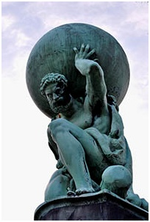
Suspension Of Earth In Space –
Job 26:7 (2000-1600 BC).
(Clear, in unscientific terms.)
When men thought the Earth was flat and supported.
1608 AD: Invention of the telescope by a Dutch optician, Hans Lippershey.
1687 AD: Sir Isaac Newton and his “Law of Universal Gravitation” (Principia). The earth is suspended in its orbit by the attraction of the sun.
Earth weighs six billion trillion (6 x 10²¹) tons. To replace the gravitational pull of the sun it would take the strength of a steel cable 8,000 miles in diameter!

Slide 10
Number Of Stars - Genesis 15:5 (~1400 BC);
Jeremiah 33:22 (~600 BC). (cf. Isaiah 40:26;
Psalms 147:4; Romans 1:20)
150 BC: Hipparchus taught there were less than 3,000 stars. (A Greek astronomer and mathematician who discovered the precession of the equinoxes, calculated the length of the year to within 6 ½ minutes, compiled the first known star catalog, and made an early formulation of trigonometry.)
150 AD: Ptolemy counted 1,056 and claimed the actual number was not over 3,000.
1608 AD: Galileo used a telescope and announced the number of stars “innumerable.”
Today, astronomers estimate there are about 100 thousand million stars in the Milky Way alone. Outside that, there are millions upon millions of other galaxies also.

Slide 11
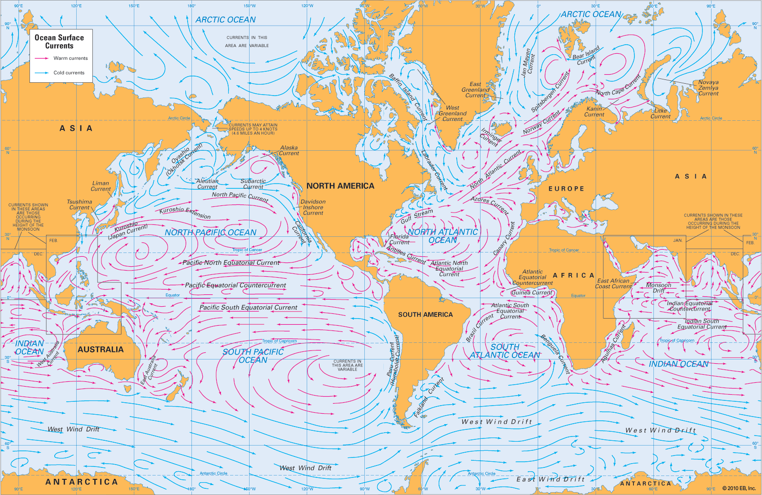
Paths Of The Seas - Psalms 8:8
(~1000 BC).
1855 AD: Matthew Fontaine Maury, upon hearing Psalms 8:8 read to him by his son, set out to discover and chart the oceans’ sea lanes and currents. (Statue of Maury in Richland, VA).

Slide 12
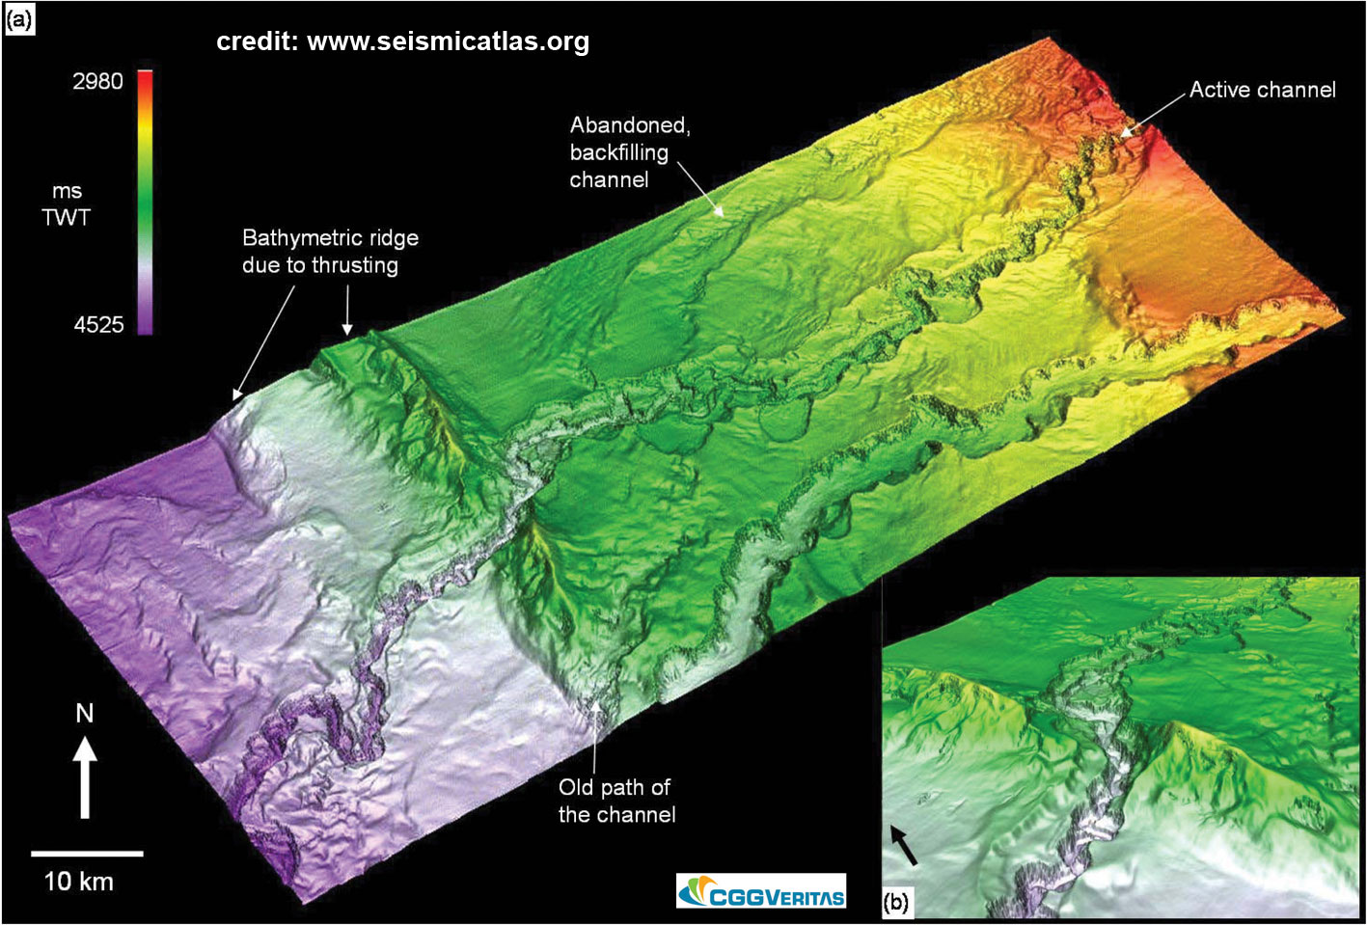
Channels In The Sea - 2 Samuel 22:16 (~1000 BC).
1504 AD: Juan de la Costa made the first ocean soundings, but did nothing to change the universal view that the ocean floors were flat, sandy beds like our deserts.
1840 AD: James Clark Rose made oceanic soundings to a depth of nearly 2,000 fathoms (12,000 ft.).
1971 AD: First complete map of the ocean floor showing the “recesses of the deep.”

Slide 13
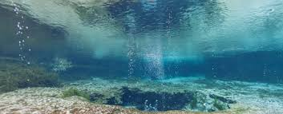
Springs Of The Sea - Job 38:16 (~2000-1600 BC); Genesis 7:11; 8:2 (~1400 BC.)
1930 AD: Fresh water springs on the ocean floor.
Scientists have discovered huge reserves of freshwater beneath the oceans kilometers out to sea, providing new opportunities to stave off a looming global water crisis … “The volume of this water resource is a hundred times greater than the amount we’ve extracted from the Earth’s sub-surface in the past century since 1900” Dr Vincent Post of the National Centre for Groundwater Research and Training (NCGRT) and the School of the Environment at Flinders University. https://www.sciencedaily.com/releases/2013/12/131208085304.htm December 8, 2013

Slide 14

Springs Of The Sea - Job 38:16 (~2000-1600 BC);
Genesis 7:11; 8:2 (~1400 BC.)
1945 AD: Underwater volcanoes discovered.
“Although most of the active volcanoes we see on land occur where plates collide, the greatest number of the Earth’s volcanoes are hidden from view, occurring on the ocean floor along spreading ridges.” https://oceanservice.noaa.gov/facts/volcanoes.html
We All Nearly Missed The Largest Underwater Volcano Eruption Ever Recorded. What? PETER DOCKRILL 15 JAN 2018

Slide 15
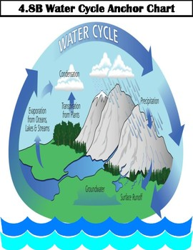
The Water-Vapor Cycle - Job 36:27-28 (2000-1600 BC); Ecclesiastes 1:7 (~1000 BC).
Sea not full – Evaporation and water cycles.
350 BC: Aristotle comprehended the water-vapor cycle and published his “Meteorlogica.”
1770 AD: Benjamin Franklin observed movement of water by storms (river-to-sea-to-river water cycle).

Slide 16
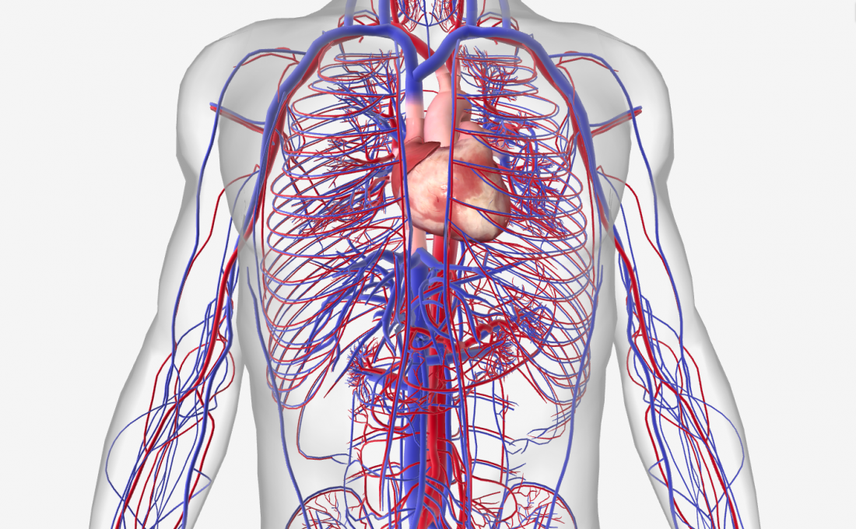
Life Is In The Blood - Leviticus 17:11 (~1400 BC)
~350 BC: Herophilos, physician of the Museum of Alexandria, advocated blood letting as a means to get rid of disease.
1616 AD: Dr. William Harvey, British physician, discovered blood circulates and is used over and over.
  Circulatory system involves estimated 60,000 – 80,000 miles (earth is 25,000 miles around); circulates an average of 1,400 times a day.

Slide 17
Cosmology/Astronomy
Time had a beginning – 2 Timothy 1:9, Titus 1:2,
1 Corinthians 2:7; Genesis 1:1, 2:4, Isaiah 42:5, etc.
The universe was created from the invisible.
Hebrews 11:3
The dimensions of the universe were created.
Romans 8:38-39
The universe is expanding. Job 9:8, Psalms 104:2,
Isaiah 40:22, Isaiah 42:5, Isaiah 44:24, Isaiah 45:12,
Isaiah 48:13, Isaiah 51:13, Jeremiah 10:12,
Jeremiah 51:15, Zechariah 12:1

Slide 18
The universe is winding down and will “wear out” (second law of thermodynamics ensures that the universe will run down).
Psalms 102:25-27

Slide 19
Number of stars exceeds a billion.
Genesis 22:17, Jeremiah 33:22
Every star is different. 1 Corinthians 15:41
Stars sing. Job 38:7
Pleiades and Orion are gravitationally bound star groups. Job 38:31
Light is in motion. Job 38:19-20
The earth is controlled by the heavens.
Job 38:33
Earth is a sphere. Isaiah 40:22 Job 26:10
Earth is suspended in space. Job 26:7

Slide 20
Earth Sciences
Water cycle described. Ecclesiastes 1:7;
Isaiah 55:10, Job 36:27-28
Valleys exist on the bottom of the sea.
2 Samuel 22:16
Vents exist on the bottom of the sea.
Job 38:16
Ocean currents in the sea. Psalms 8:8
Air has weight. Job 28:25
Winds blow in circular paths.
Ecclesiastes 1:6

Slide 21
Biology
The chemical nature of human life.
Genesis 2:7; 3:19
Life of creatures are in the blood.
Leviticus 17:11
The nature of infectious diseases.
Leviticus 13:46
Importance of sanitation to health.
Numbers 19; Deuteronomy 23:12-13; Leviticus 7-9

Slide 22
Conclusion:
Negatively: Scientific Knowledge Contemporary With The Writers of the Bible Is Not Found In The Bible! (No wrong notions, superstitions, etc.).
Positively: An Understanding of the Physical World Is Revealed Which Transcends The Writers’ Ability To Discover At The Time They Wrote The Bible!
The Bible is not the product of man’s knowledge and ability
It is the inspired word of God.
2 Timothy 3:16-17

